Slide 1

Department of Computer Science Gujarat University
5 Year Integrated M.Sc.(Computer Science)
Semester - VII
Department Grievance
Management
Presented By:
Janvi Chauhan(03)
Under the Guidance of :
Dr. Hiren Joshi

Slide 2
Table of Content
Project Profile
Project Description
Introduction
Functionality
System Architecture
System Design(Diagrams)
Use Case
Activity
Class Diagram
Data Dictionary
Screen Shots
Future Work
Bibliography

Slide 3
Project Profile
TITLE | DESCRIPTION
Project Title | Department Grievance Management
Aim of the Project | addressing concerns and complaints regarding various aspects of our department's facilities and services
Project duration | 6 month
Team size | 1 Member
Tools used | Visual Studio code
Technologies used | HTML,CSS,Bootstrap,Javascript, php,AJAX
Software and hardware environment requirement to use for an application | Any modern web browser is compatible with HTML, CSS, and JavaScript.
Guide | Dr. Hiren Joshi

Slide 4
Project Description

Slide 5
Introduction
Discusses concerns and complaints about department facilities and services.
Simplifies the submission and resolution of grievances, fostering a welcoming and supportive environment.
Allows students to easily lodge concerns about issues they encounter.

Slide 6
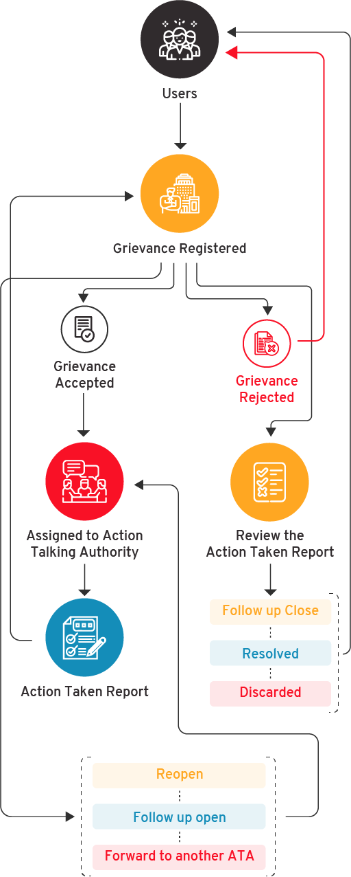

Slide 7
Objectives
Centralized Grievance Management
Efficient Handling of Complaints
Timely Resolution
Improved Communication
Transparency and Accountability

Slide 8
Student Functionality
Generates Complaint
Upload photos /media required as attachment with the complaint
View Status
View Grievance

Slide 9
Faculty Functionality
View Grievance
Update Status
Handling the grievances according to the category.
Delete Grievance
Generate Reports

Slide 10
Admin Functionality
View Grievance
Manages Users
Manages Grievance
Can Assign any faculty to specific category as well as to specific complaint manually .
Notify faculty using email.
Generates the report on the basis of the grievance received
such as number of grievances filed , categories of grievance and status of grievance.

Slide 11
System Architecture

Slide 12
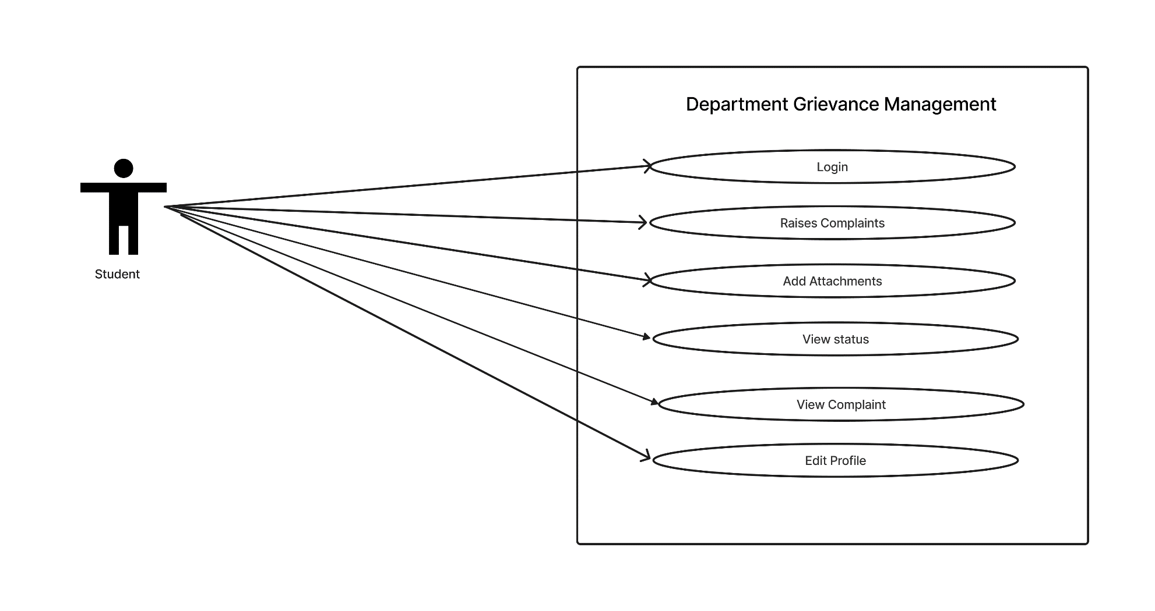
Use Case Diagram of Student

Slide 13
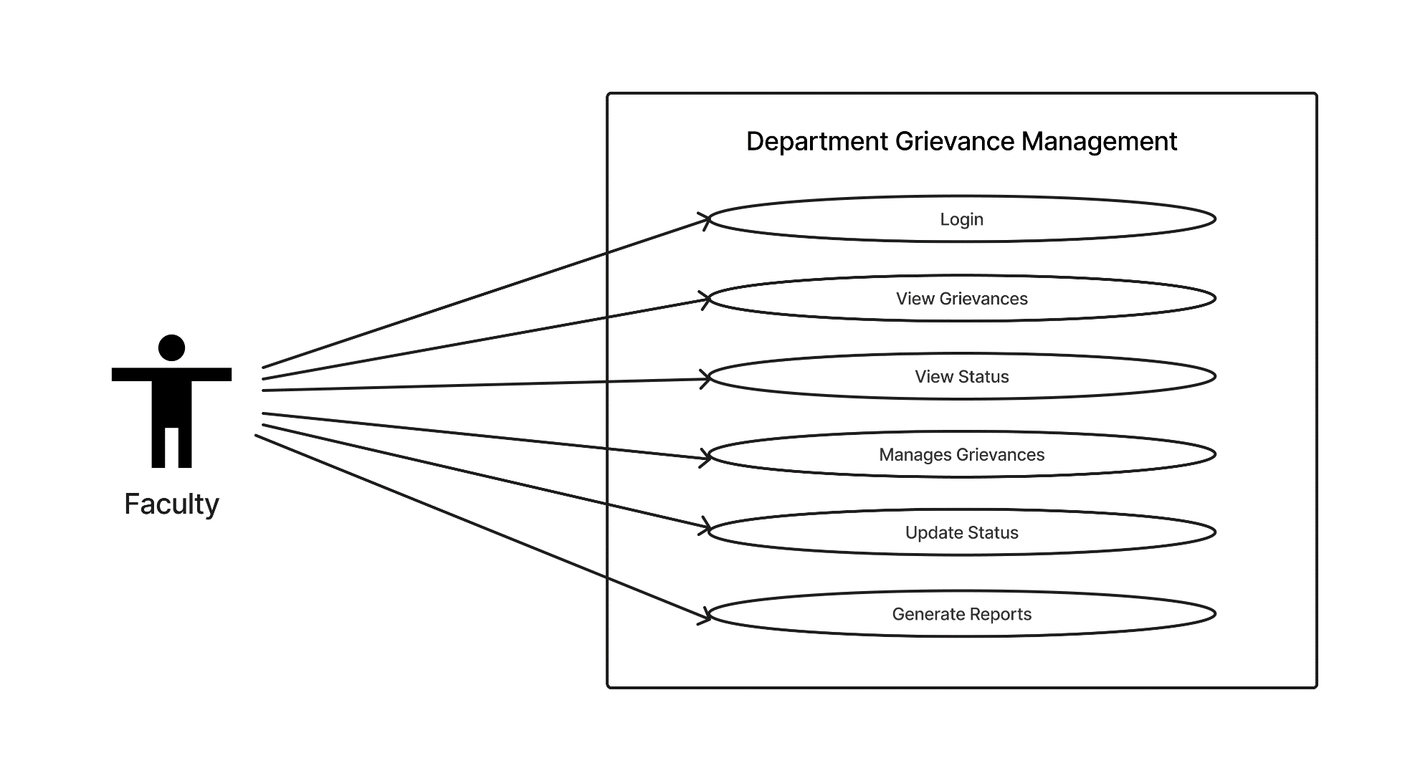
Use Case Diagram of Faculty

Slide 14
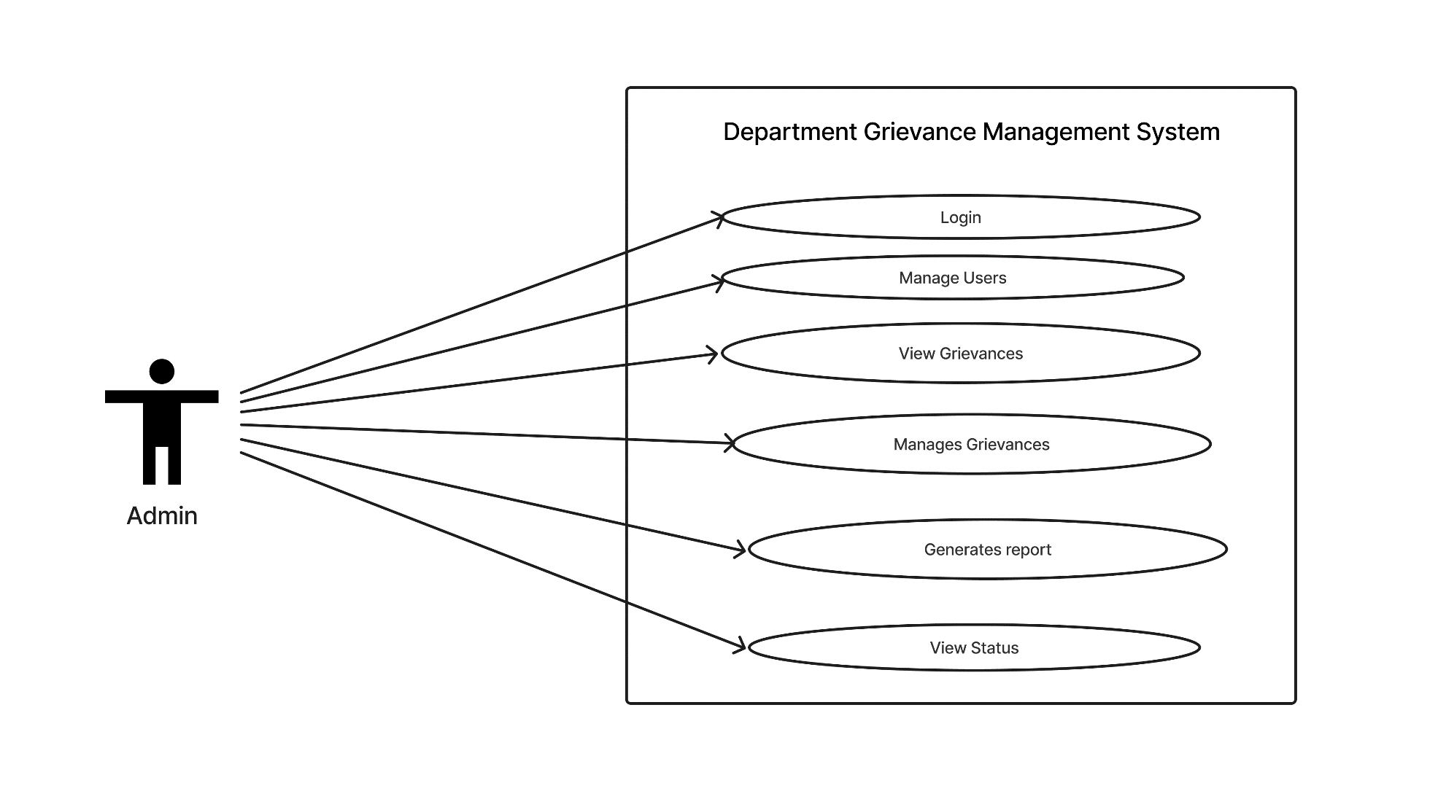
Use Case Diagram of Admin

Slide 15
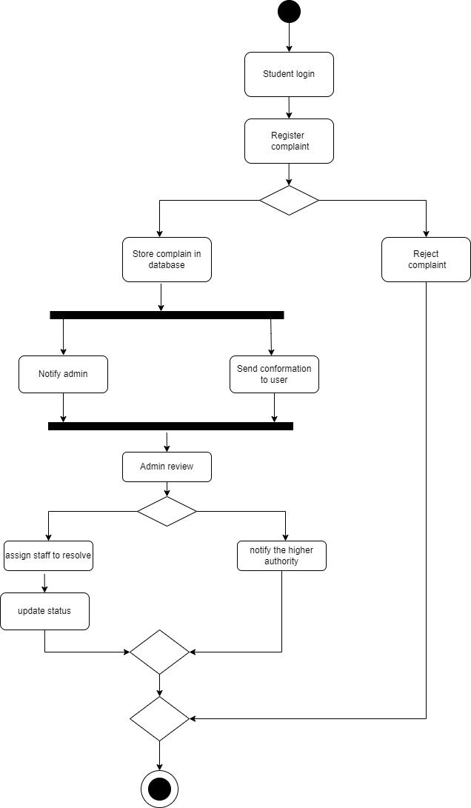
Activity Diagram

Slide 16
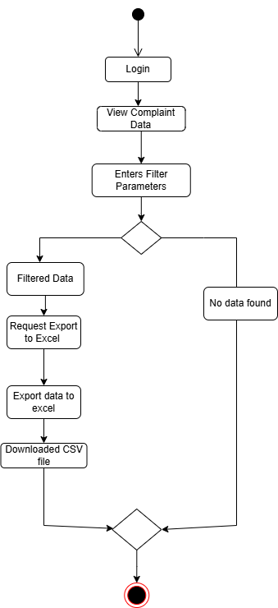
Activity Diagram

Slide 17
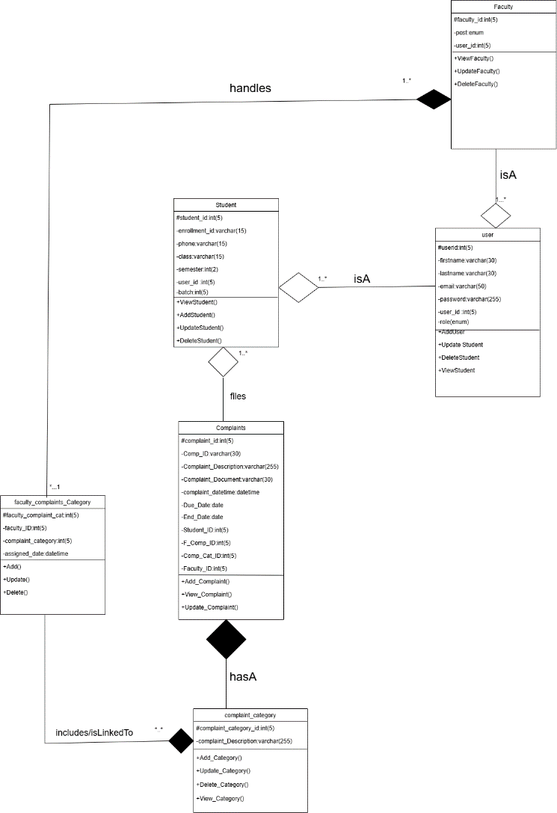
Class Diagram

Slide 18
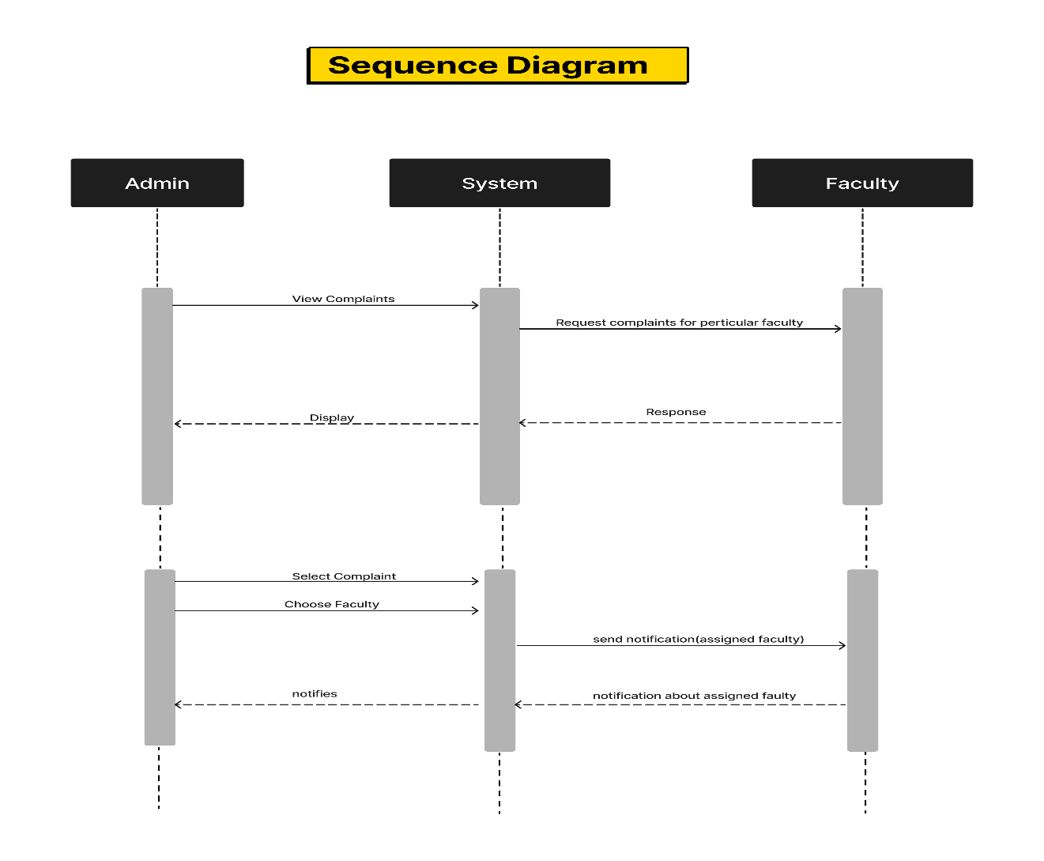
Sequence Diagram

Slide 19
Data Dictionary

Slide 20
User Table
SERIAL NO | FIELD NAME | TYPE | SIZE | CONSTRAINTS | SAMPLE DATA
1 | user_id | INT | 5 | Primary key | 12
2 | firstname | VARCHAR | 30 |  | Kathan
3 | lastname | VARCHAR | 30 |  | Sharma
4 | email | VARCHAR | 50 |  | kathan@gmail.com
5 | password | VARCHAR | 255
6 | role | enum |  |  | admin

Slide 21
Complaints Table

Slide 22
Complaints Table
SERIAL NO | FIELD NAME | TYPE | SIZE | CONSTRAINTS | SAMPLE DATA
1 | complaint_id | INT | 5 | Primary key | 10
2 | Comp_ID | VARCHAR | 11 |  | E-265533760
3 | Complaint_Description | VARCHAR | 255 |  | System 116 in lab 3 not working.
4 | Complaint_Document | VARCHAR | 100 |  | ./uploads/complaint.pdf
5 | complaint_datetime | DATETIME |  |  | 2024-10-28 18:29:13
6 | Due_Date | Date |  |  | 2024-11-12
7 | End_Date | Date |  |  | 2024-11-01
8 | status | enum |  |  | Pending ,Processing,Resolved
9 | Student_ID | INT | 5 | Foreign key | 1
10 | Faculty_ID | INT | 5 | Foreign key | 2
11 | F_Comp_ID | INT | 5 | Foreign key | 3
12 | Complaint_Cate_ID | INT | 5 | Foreign key | 10

Slide 23
Complaint_category Table
SERIAL NO | FIELD NAME | TYPE | SIZE | CONSTRAINTS | SAMPLE DATA
1 | complaint_category_id | INT | 5 | Primary key | 11
2 | category_description | VARCHAR | 30 |  | Cleaning and management

Slide 24
Student Table
SERIAL NO | FIELD NAME | TYPE | SIZE | CONSTRAINTS | SAMPLE DATA
1 | student_id | INT | 5 | Primary key | 11
2 | enrollment_id | VARCHAR | 15 |  | STU98765
3 | phone | VARCHAR | 15 |  | 345678234
4 | class | VARCHAR | 15 |  | Msc(cs)
5 | semester | INT | 2 |  | 3
6 | batch | INT | 2 |  | 2
7 | user_id | INT | 5 | Foreign key | 43

Slide 25
Faculty Table
SERIAL NO | FIELD NAME | TYPE | SIZE | CONSTRAINTS | SAMPLE DATA
1 | faculty_id | INT | 5 | Primary key | 14
2 | post | enum |  |  | Assistant Professor
3 | user_id | INT | 5 | Foreign key | 17

Slide 26
Faculty_complaint category Table
SERIAL NO | FIELD NAME | TYPE | SIZE | CONSTRAINTS | SAMPLE DATA
1 | Faculty_complaint_cat | INT | 5 | Primary key | 1
2 | Faculty_ID | INT | 5 | Foreign key | 8
3 | Complaint_Category_ID | INT | 5 | Foreign key | 1
4 | assigned_date | datetime |  |  | 2024-11-21 08:50:52

Slide 27
SCREENSHOTS

Slide 28
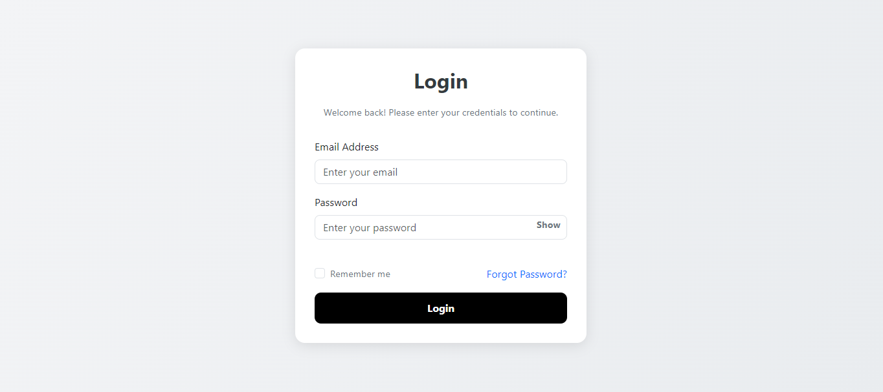
Login Form

Slide 29
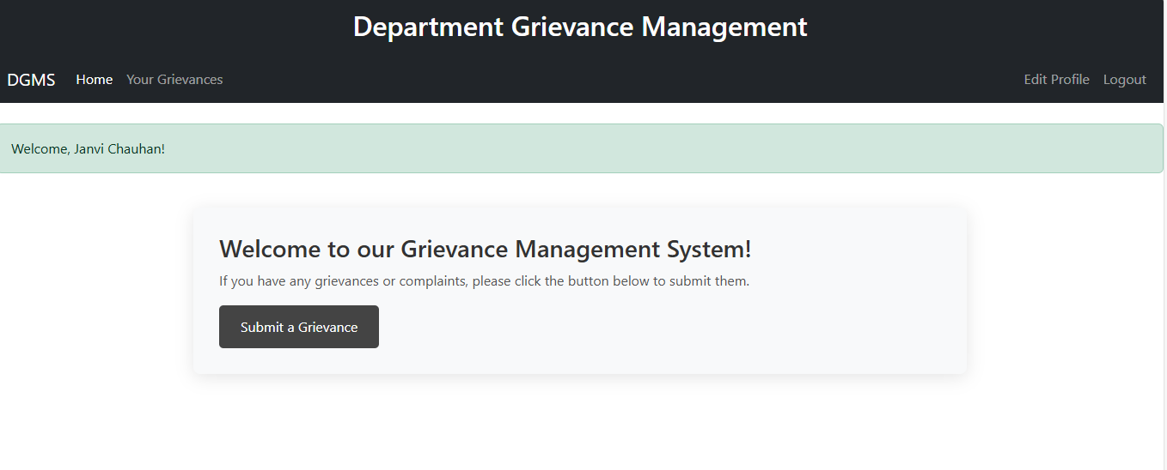
Grievance Homepage

Slide 30
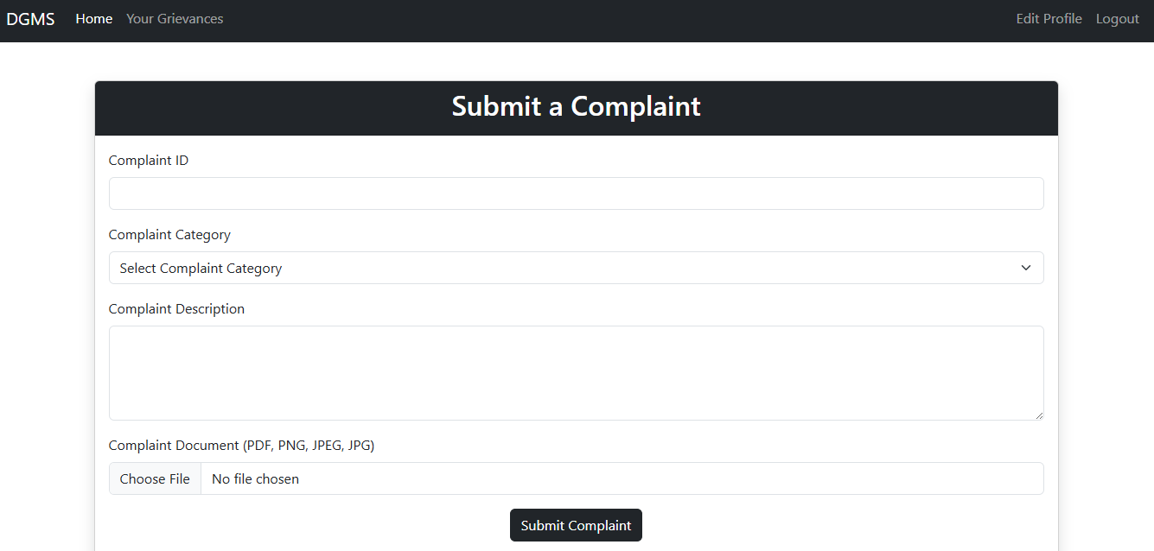
Grievance Form

Slide 31
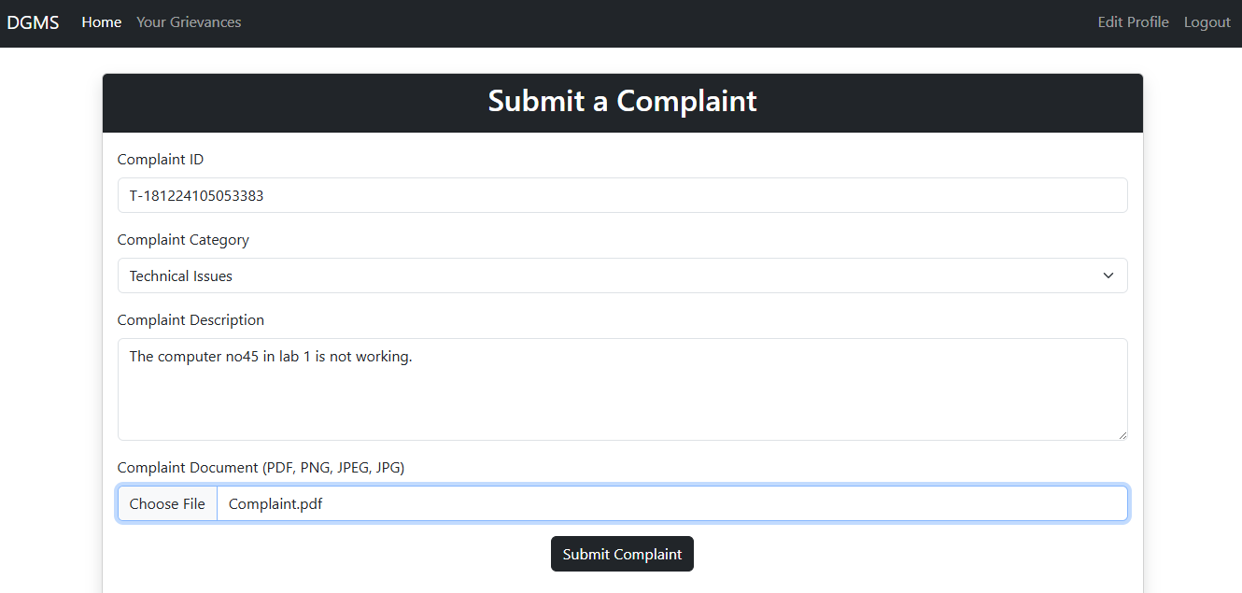

Slide 32
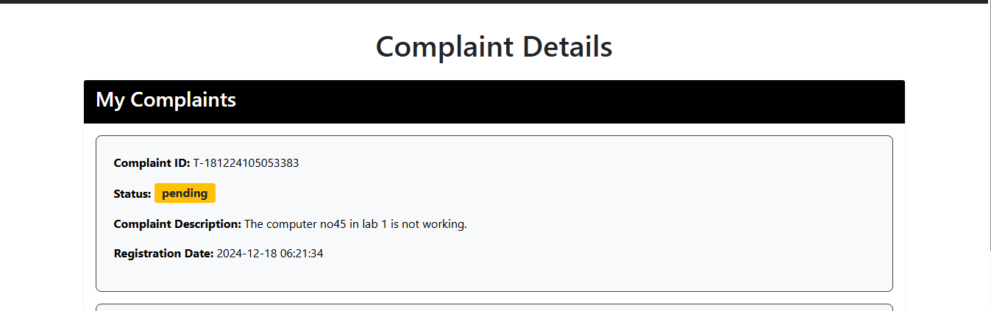
Your grievance

Slide 33
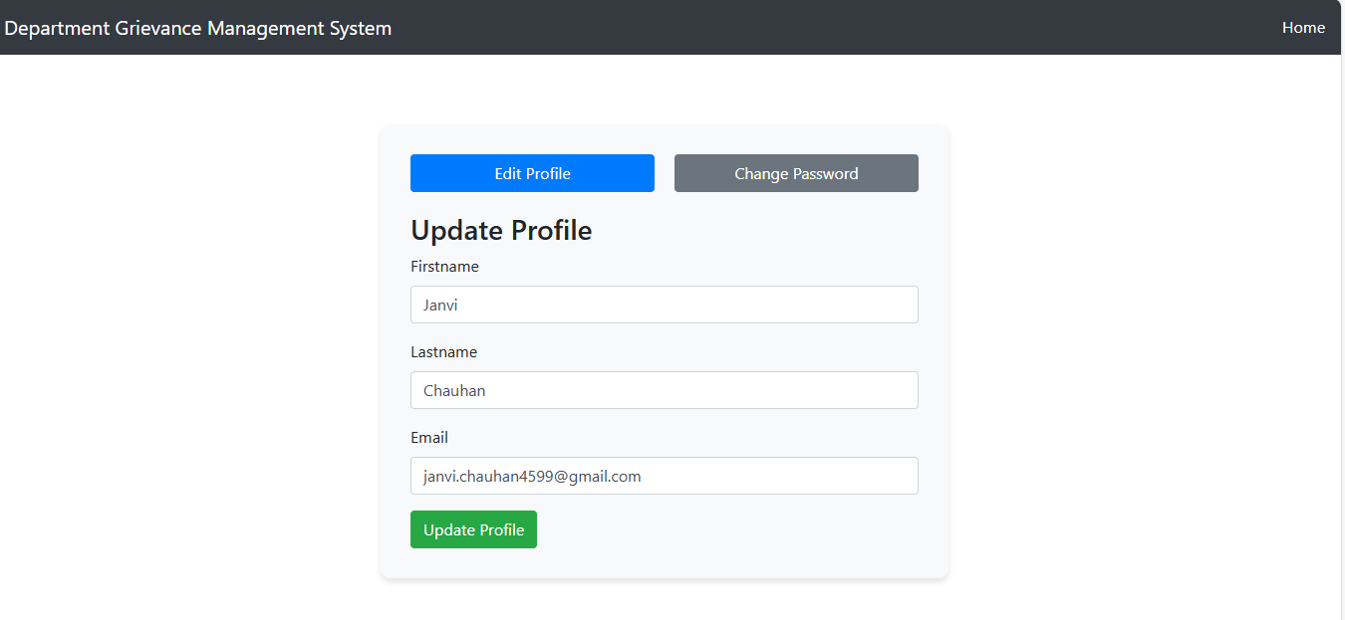
Edit Profile

Slide 34
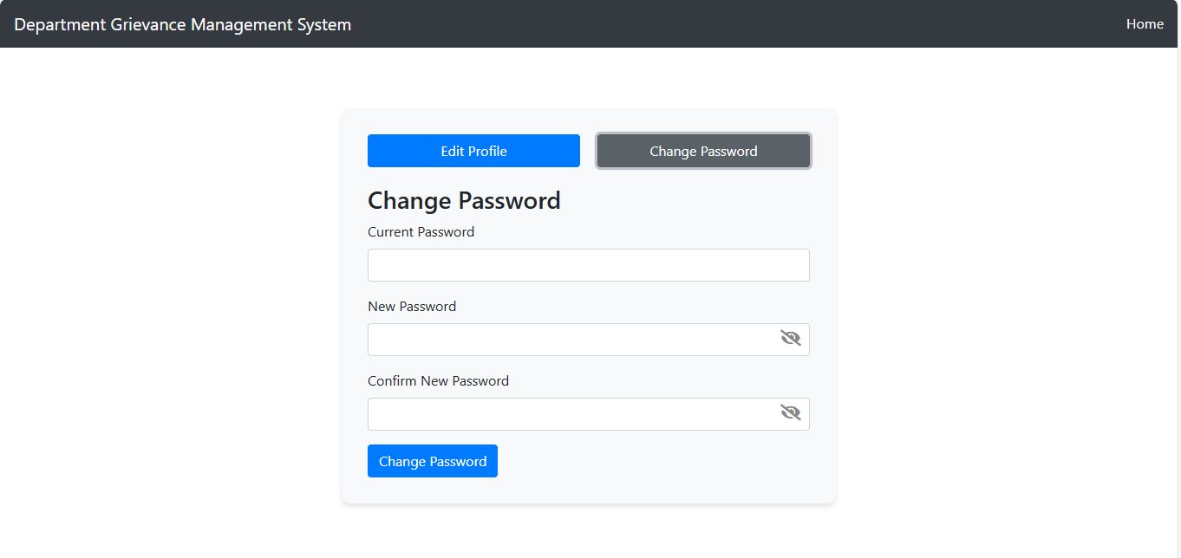
Edit Profile

Slide 35
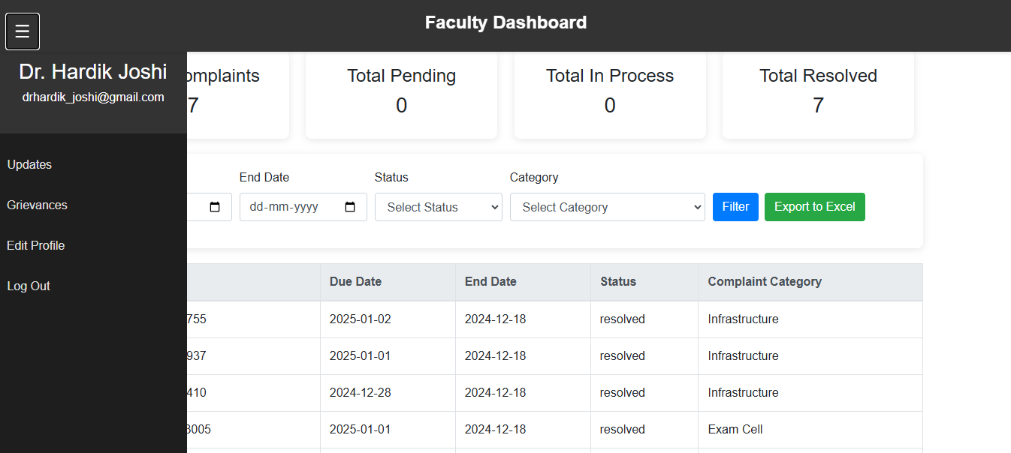
Faculty Dashboard

Slide 36
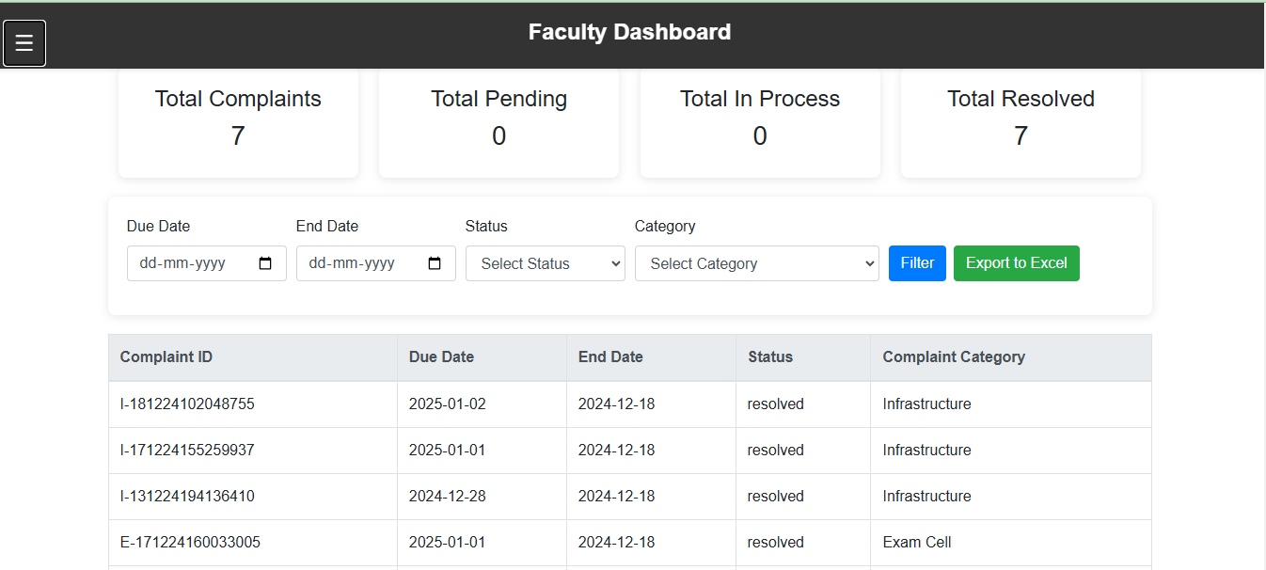
Faculty Dashboard

Slide 37
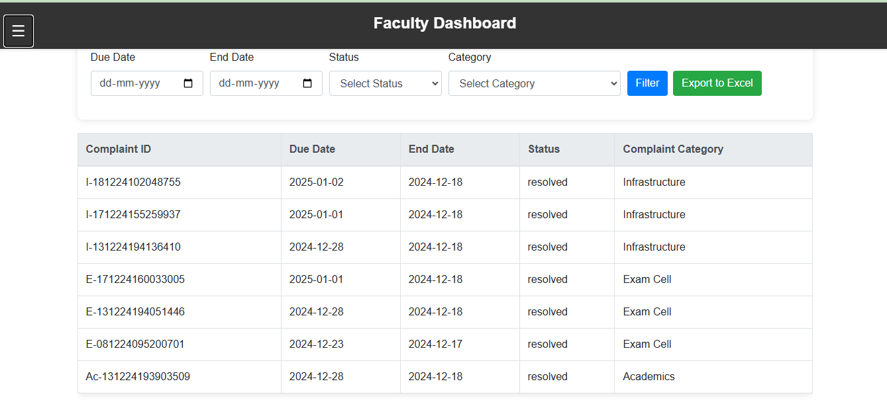
Faculty Dashboard

Slide 38
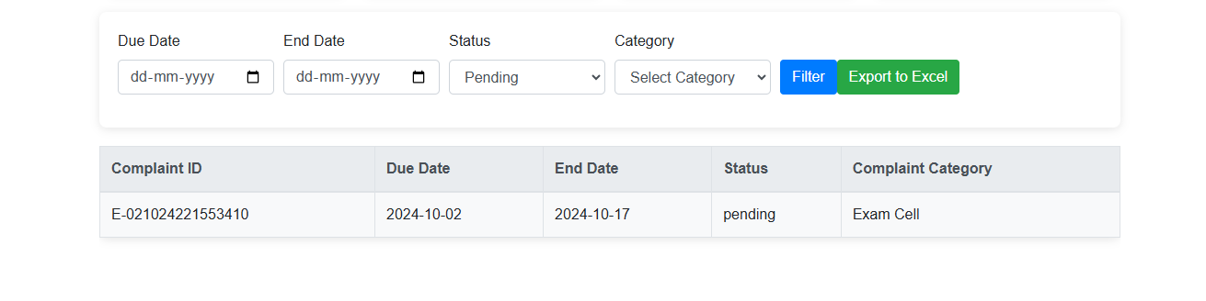
Faculty Dashboard

Slide 39
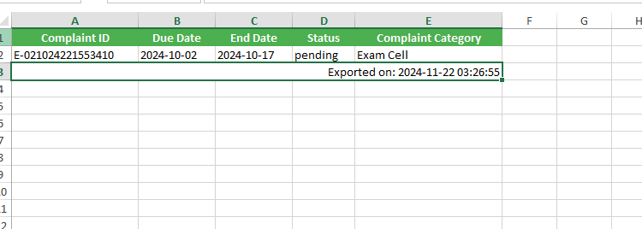
Faculty Dashboard

Slide 40
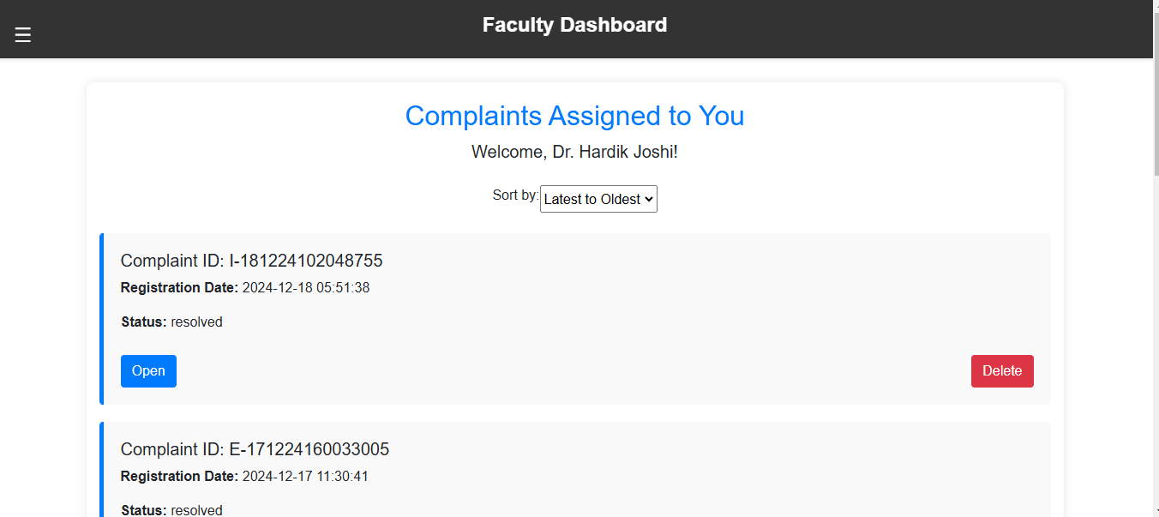
Grievances Assigned List

Slide 41
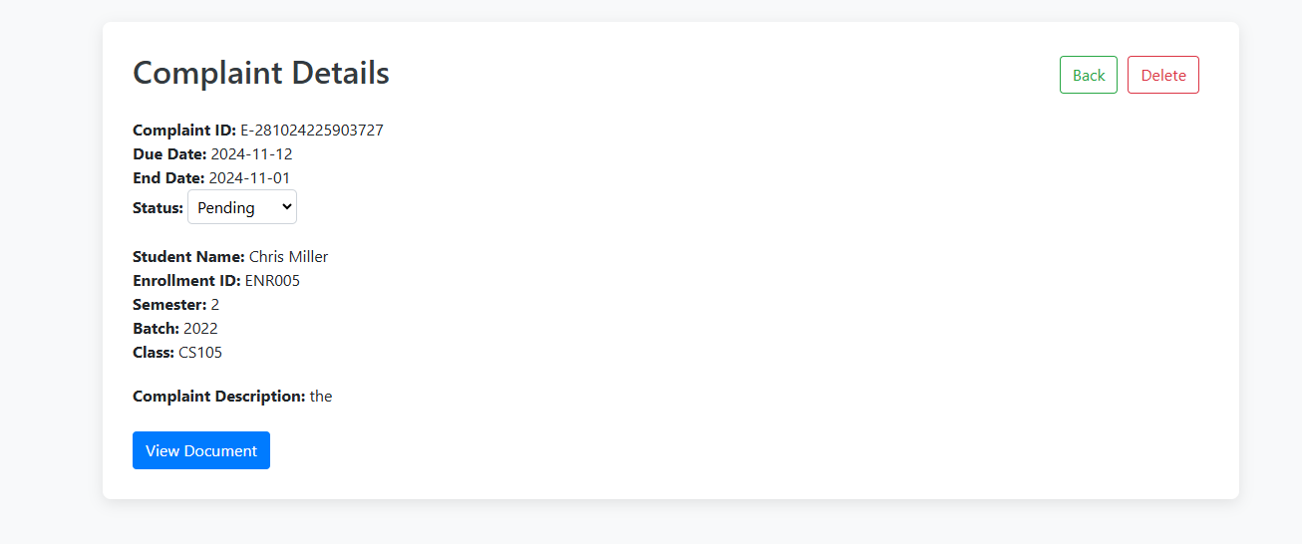
Grievances Assigned List

Slide 42
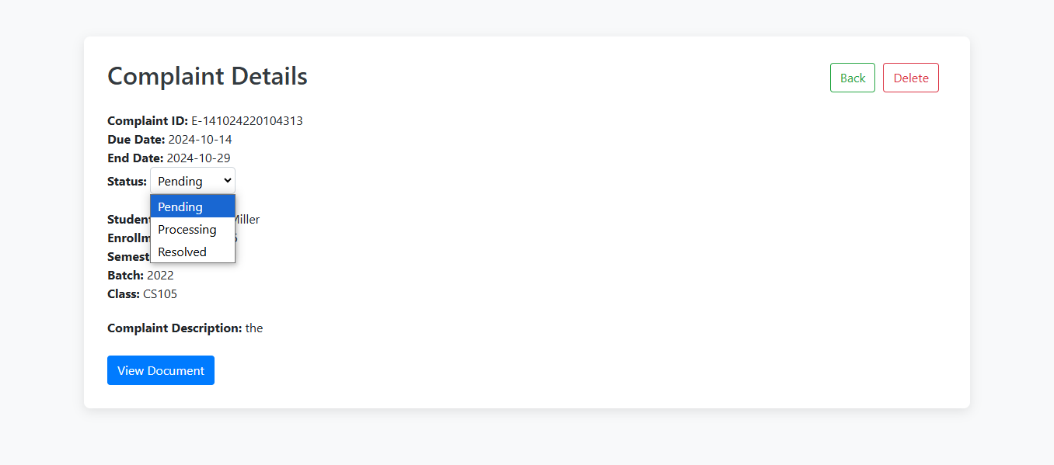
Grievances Status

Slide 43
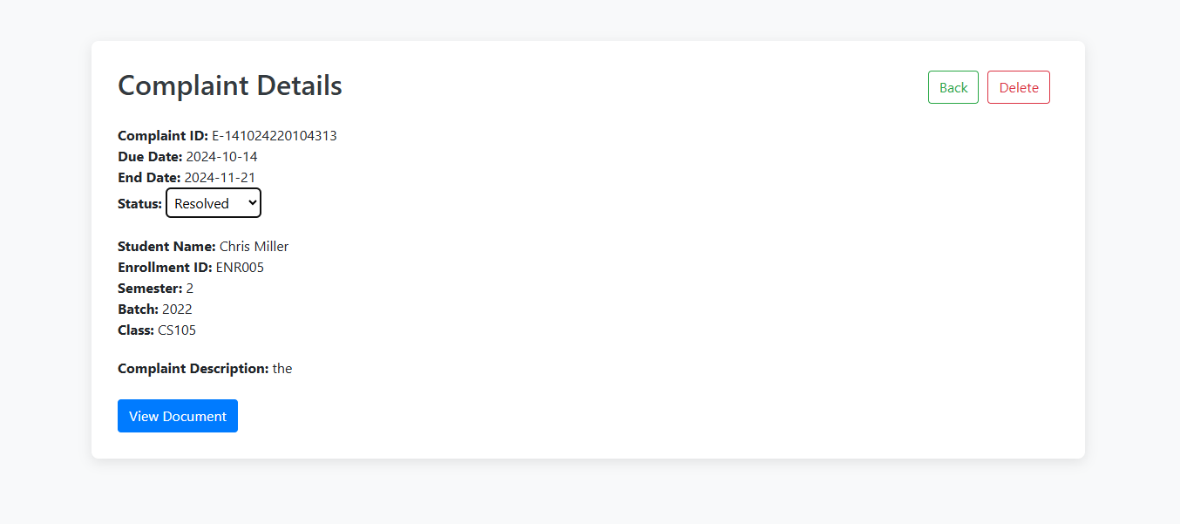
Grievances Assigned List

Slide 44
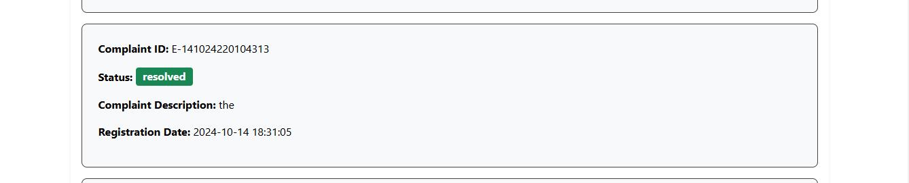
Grievances Status

Slide 45
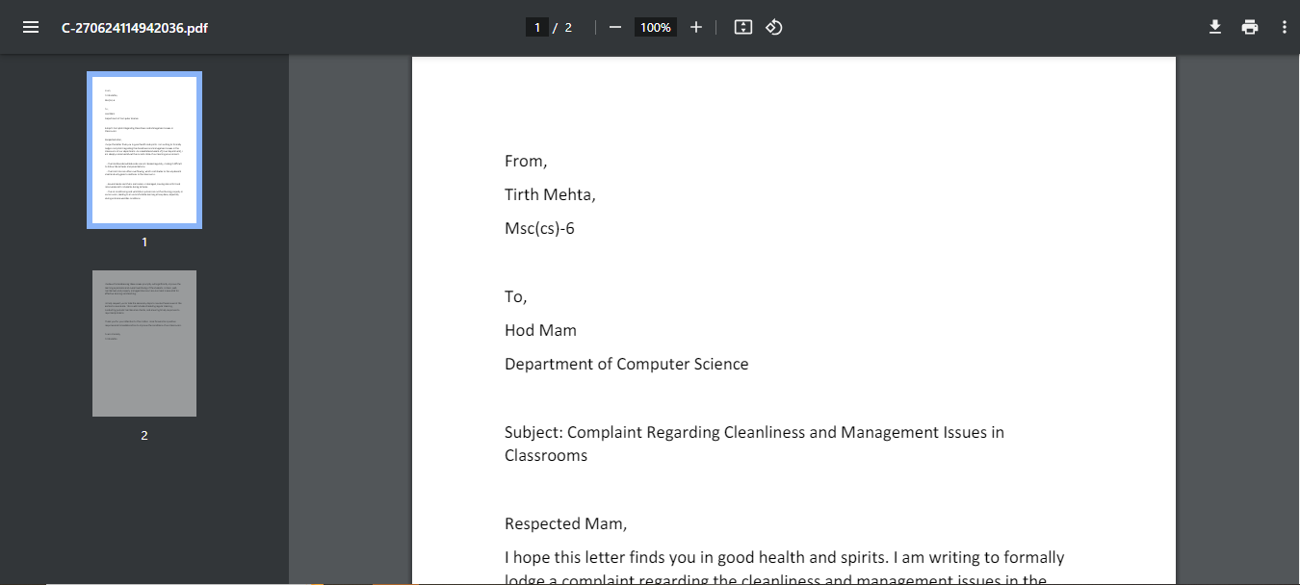
Complaint Document

Slide 46
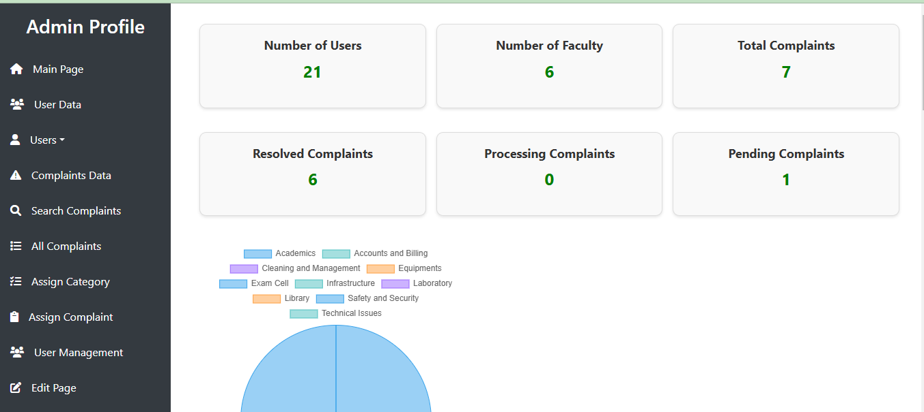
Admin Dashboard

Slide 47
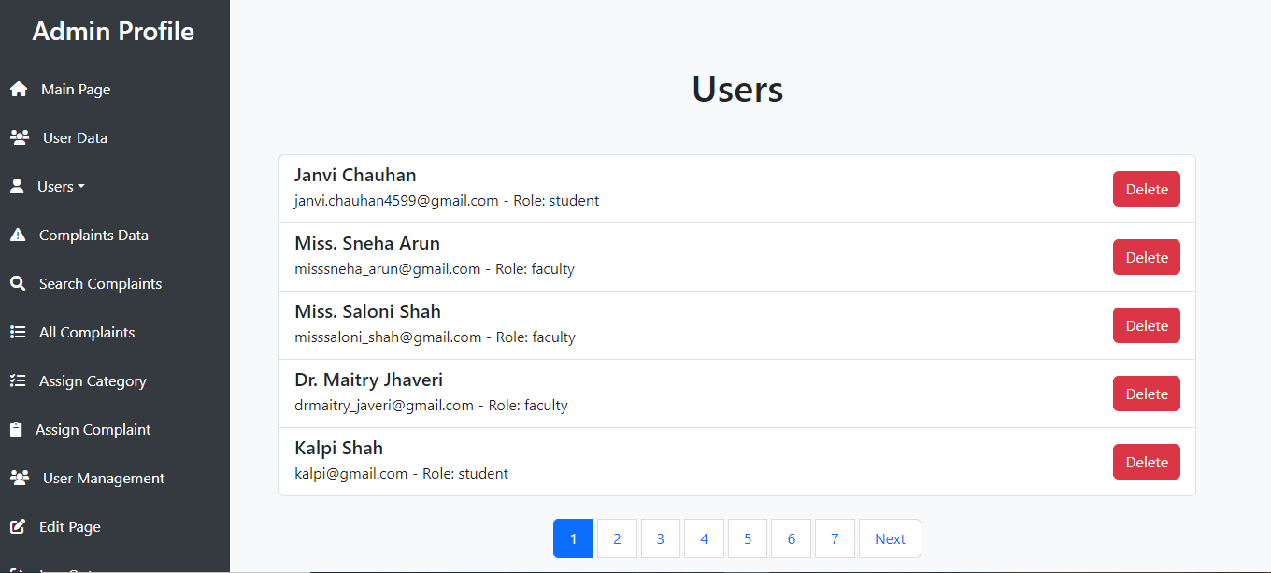
User Data

Slide 48
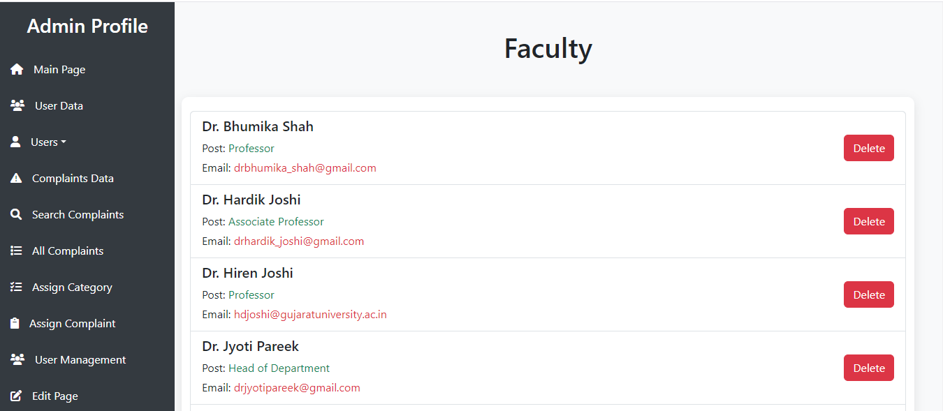
Faculty Data

Slide 49
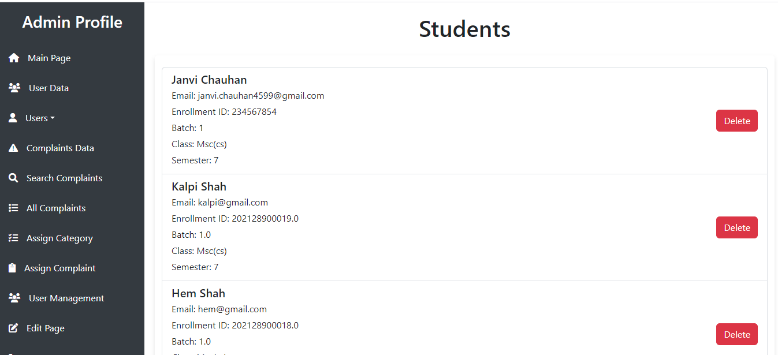
Student Users

Slide 50
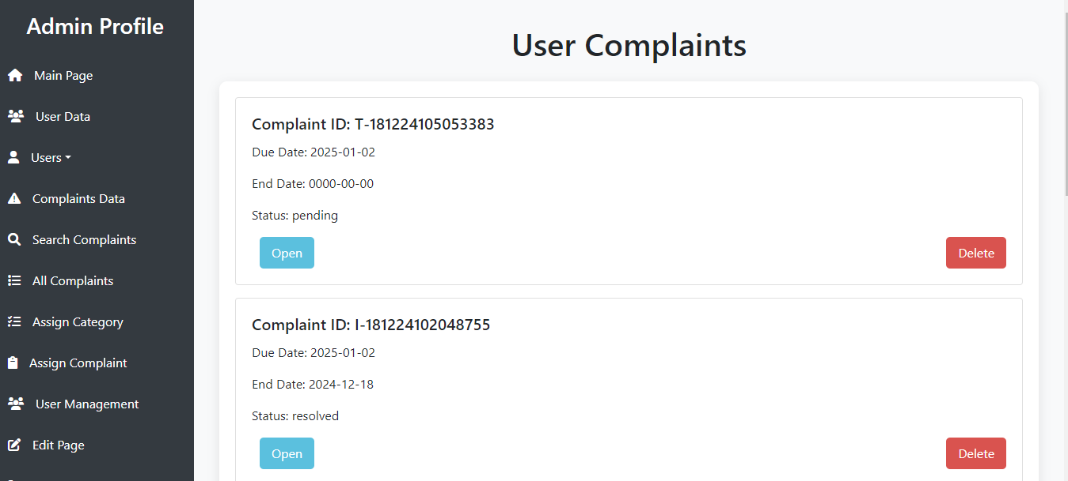
Complaints Data

Slide 51
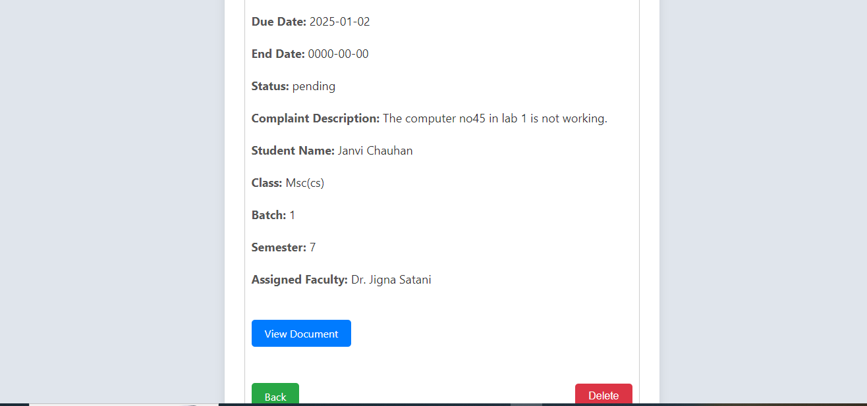
Complaints Data

Slide 52
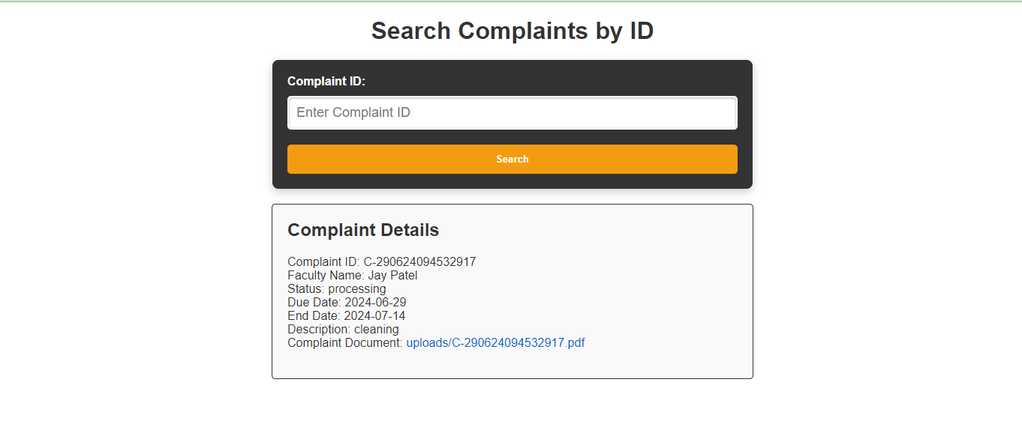
Search for Complaints

Slide 53
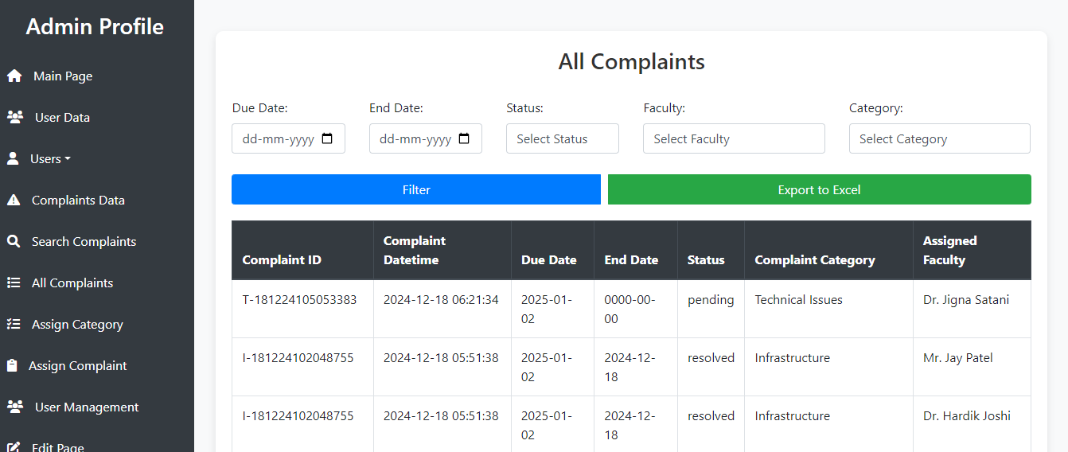
Filter Reports

Slide 54
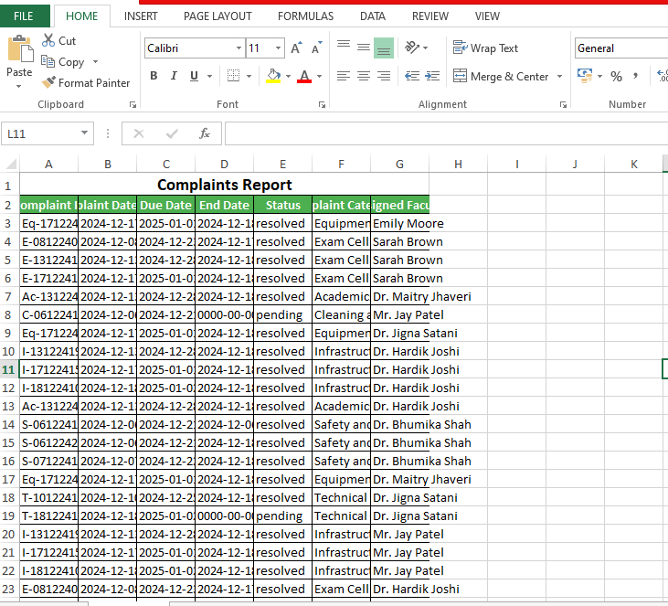
Excel Sheet

Slide 55
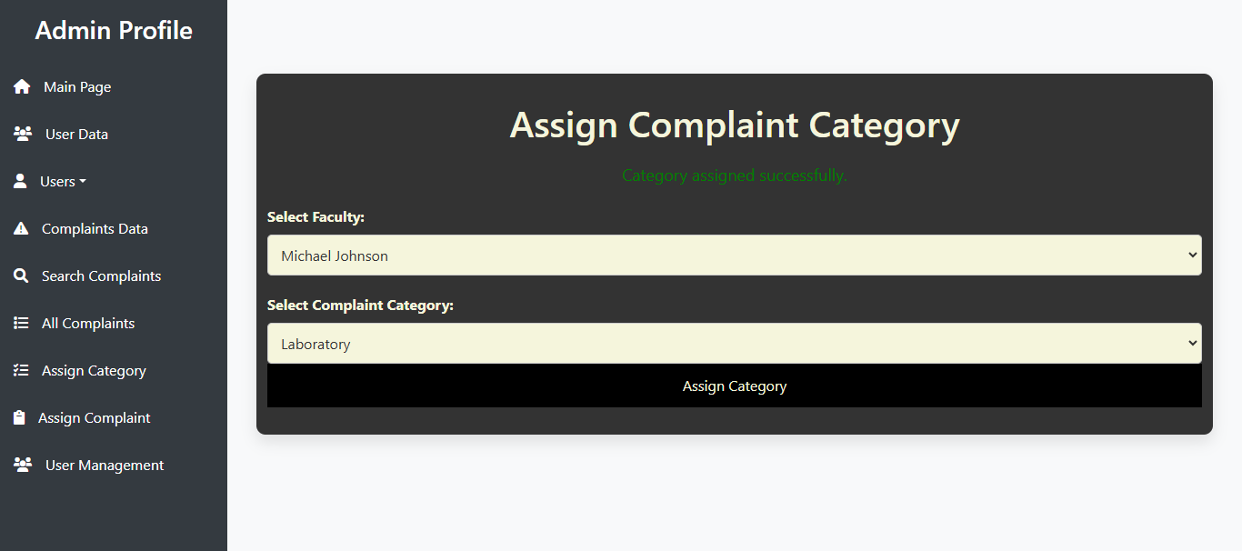
Assign Category

Slide 56
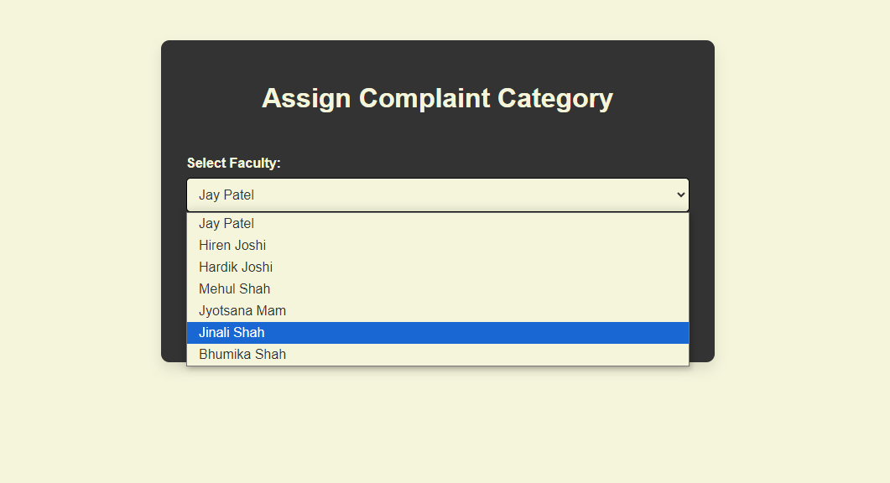

Slide 57
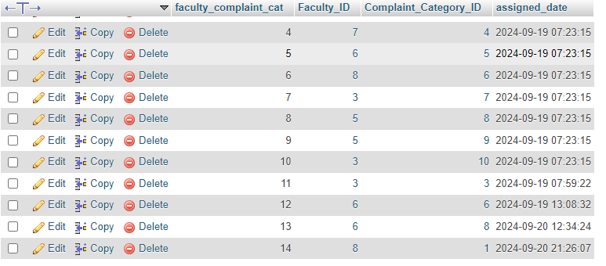
Category Assignment
The faculty_complaints_category table will have the update based on the “date time”.

Slide 58
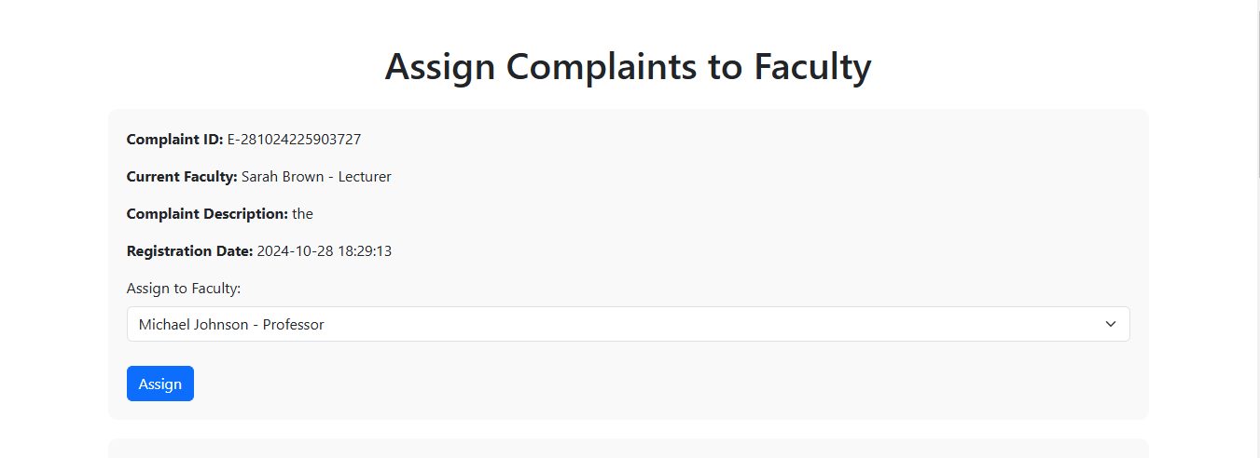
Assign Complaint to Faculty

Slide 59
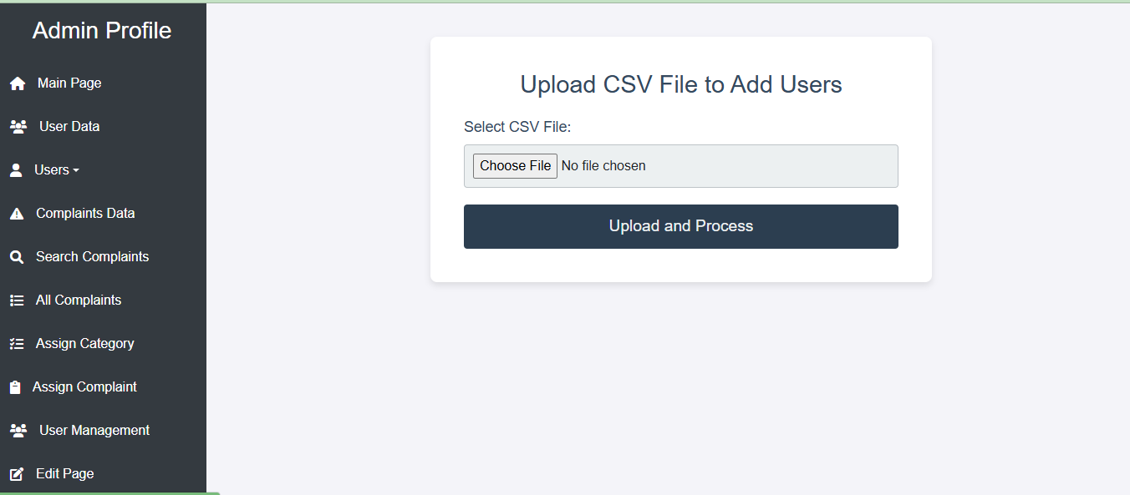
Assign Complaint to Faculty

Slide 60
Future Work
Better Data Visualization
Mail Notification (Student,faculty)

Slide 61
Bibliography
https://epfigms.gov.in/grievance/grievancemaster
https://www.w3schools.com/
https://pgportal.gov.in/

